Slide 1


E shopper
Ecommerce Project
By. Prem Prakash mali

Slide 2
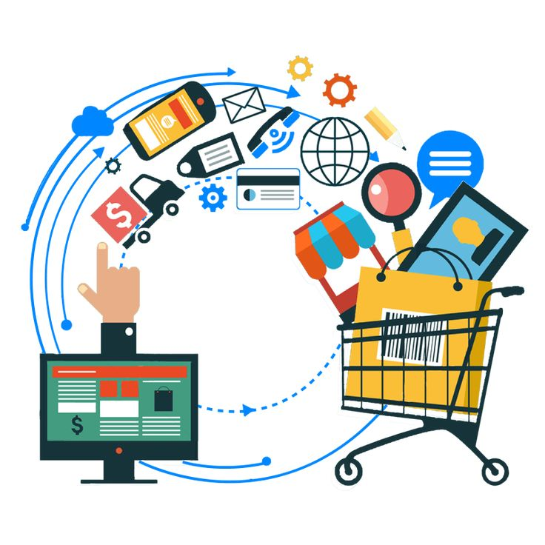
About us
Ecommerce is a method of buying and selling goods and services online. The definition of ecommerce business can also include tactics like affiliate marketing. You can use ecommerce channels such as your own website, an established selling website like Amazon, or social media to drive online sales.

Slide 3

Frame works
Languages
HTTML
CSS
JAVASCRIPT
JQUERY
REACT JS
BOOTSTRAP JS
BOOTSTRAP

Slide 4



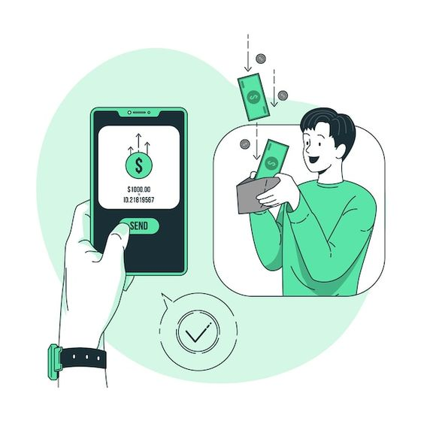
Features
Authentication:
Order Management
Authentication is the practice of verifying that someone is who they claim to be. When a customer is logging on to your ecommerce site, where they have their credit card information stored
Order management isn't just about processing sales; it's about creating a smooth journey from the moment a customer clicks 'buy' to the moment they receive their purchase.
Shopping Cart:
Payment Integration:
An ecommerce shopping cart is software that enables customers to make purchases on a website.
Ensuring the security of online transactions is paramount for eCommerce businesses. Customers need to trust that their payment information is protected.

Slide 5


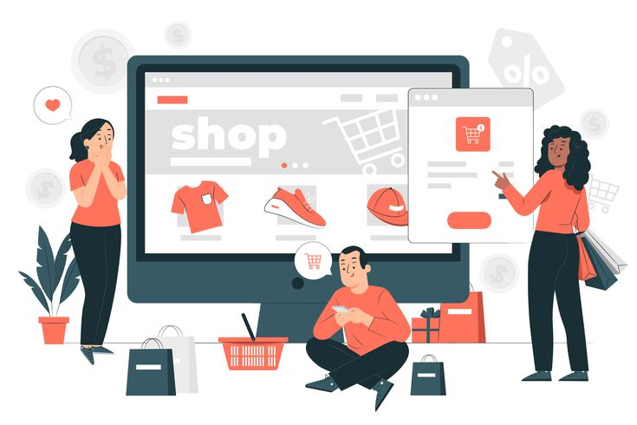
Similar projects in the market
Myntra offers a vast selection of clothing, footwear, accessories, and home decor items from various brands, catering to men, women, and children
Amazon’s marketplace hosts millions of products across various categories, including electronics, fashion, home goods, books, and more.

Slide 6


